Slide 1
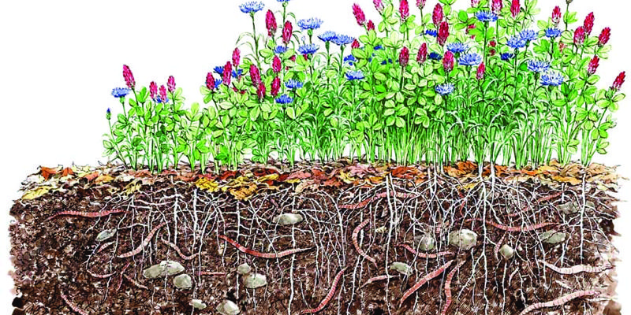
The Miracle of Cover Crops
Maile Arnold
November 2018

Slide 2
Overview
What are Cover Crops
When are they planted
When are they cut down
What are the results and benefits

Slide 3
Why We Are Warming

Slide 4
Plant Cover Crop Seeds when soil is bare
Winter:
Brassicas: mustard, daikon radish, rape
Legumes: Bell & fava beans, Vetch, Peas, clovers
Grasses: Annual rye, barley, triticale
Summer:
Buckwheat, Phacelia tanacetifolia, Queen Anne’s lace, Fennel, clovers, bishops’ weed

Slide 5
Cover Crop
Mixed Brassicas

Slide 6
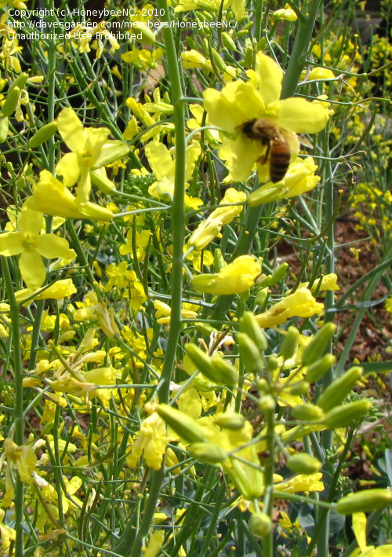
Mustard
Time to Cut Down
at 50% bloom
Daikon Radish

Slide 7
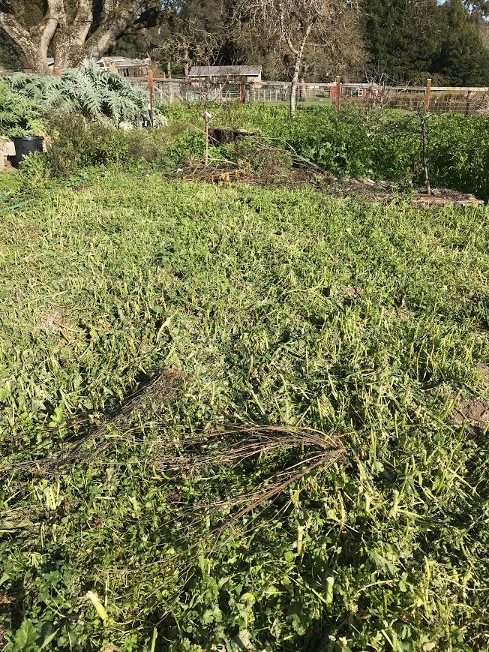
Cover Crop Cut Down
Cut with
Weed eater
Scythe
High Wheel Mower

Slide 8
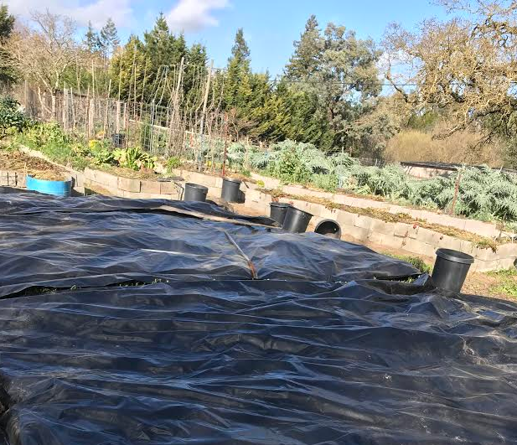
Cover Crop Composting
Cover with opaque material such as:
Tarp
Weed control fabric
Plastic sheeting
Cardboard
Maintain cover
for 4-6 weeks

Slide 9
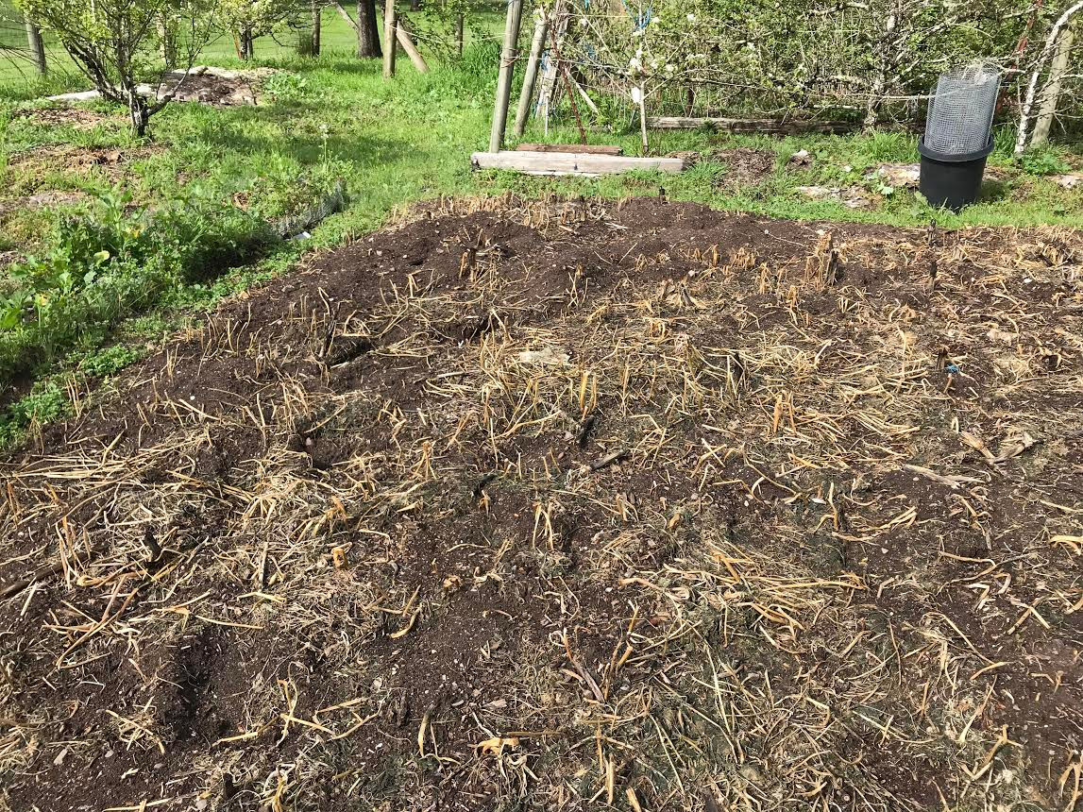
Five Weeks Later We Are Ready To Plant
Remove Opaque Material

Slide 10
Six Weeks Later
Plants Only Need Water Every 10 Days

Slide 11
What Happens Above the Soil
Plant’s leaves make sugars which feed the plant
Plant’s leaves break up the impact of raindrops preventing soil compaction
Soluble nutrients accumulate in the biomass
Flowers provide nectar and pollen to jump-start populations of pollinators and beneficial insects
Tips and pods of peas and fava beans are edible
Flowers are beautiful

Slide 12
What Happens Below the Soil
Legumes fix nitrogen as does azotobacter
Sugar from roots feeds soil microbiota
Microbiota in the soil create pore spaces in soil which store water
Carbon is sequestered in the soil
Daikon’s large deep roots decay creating a channel for rain water to penetrate deeply into the soil
Isothiocyanate from mustard kills harmful fungi and nematodes

Slide 13
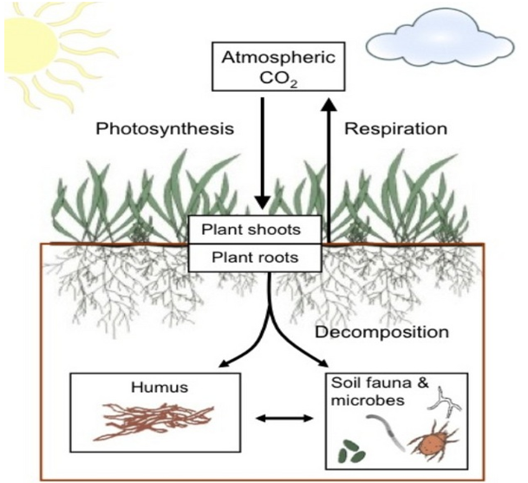
Carbon Sequestration

Slide 14
Carbon Sequestration

Slide 15
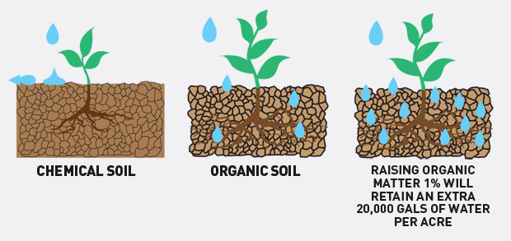
Microbiota Create Pore Spaces
Organic matter increases water holding capacity

Slide 16
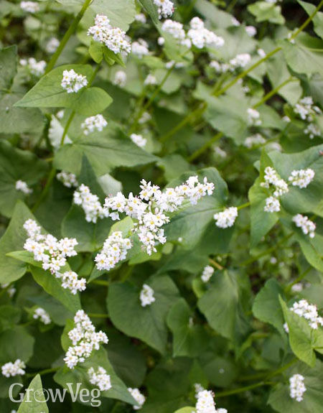
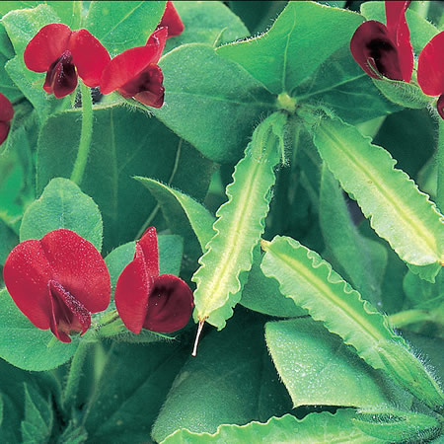
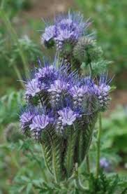
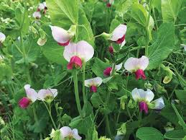
Cover Crops Can Be Beautiful

